Slide 1
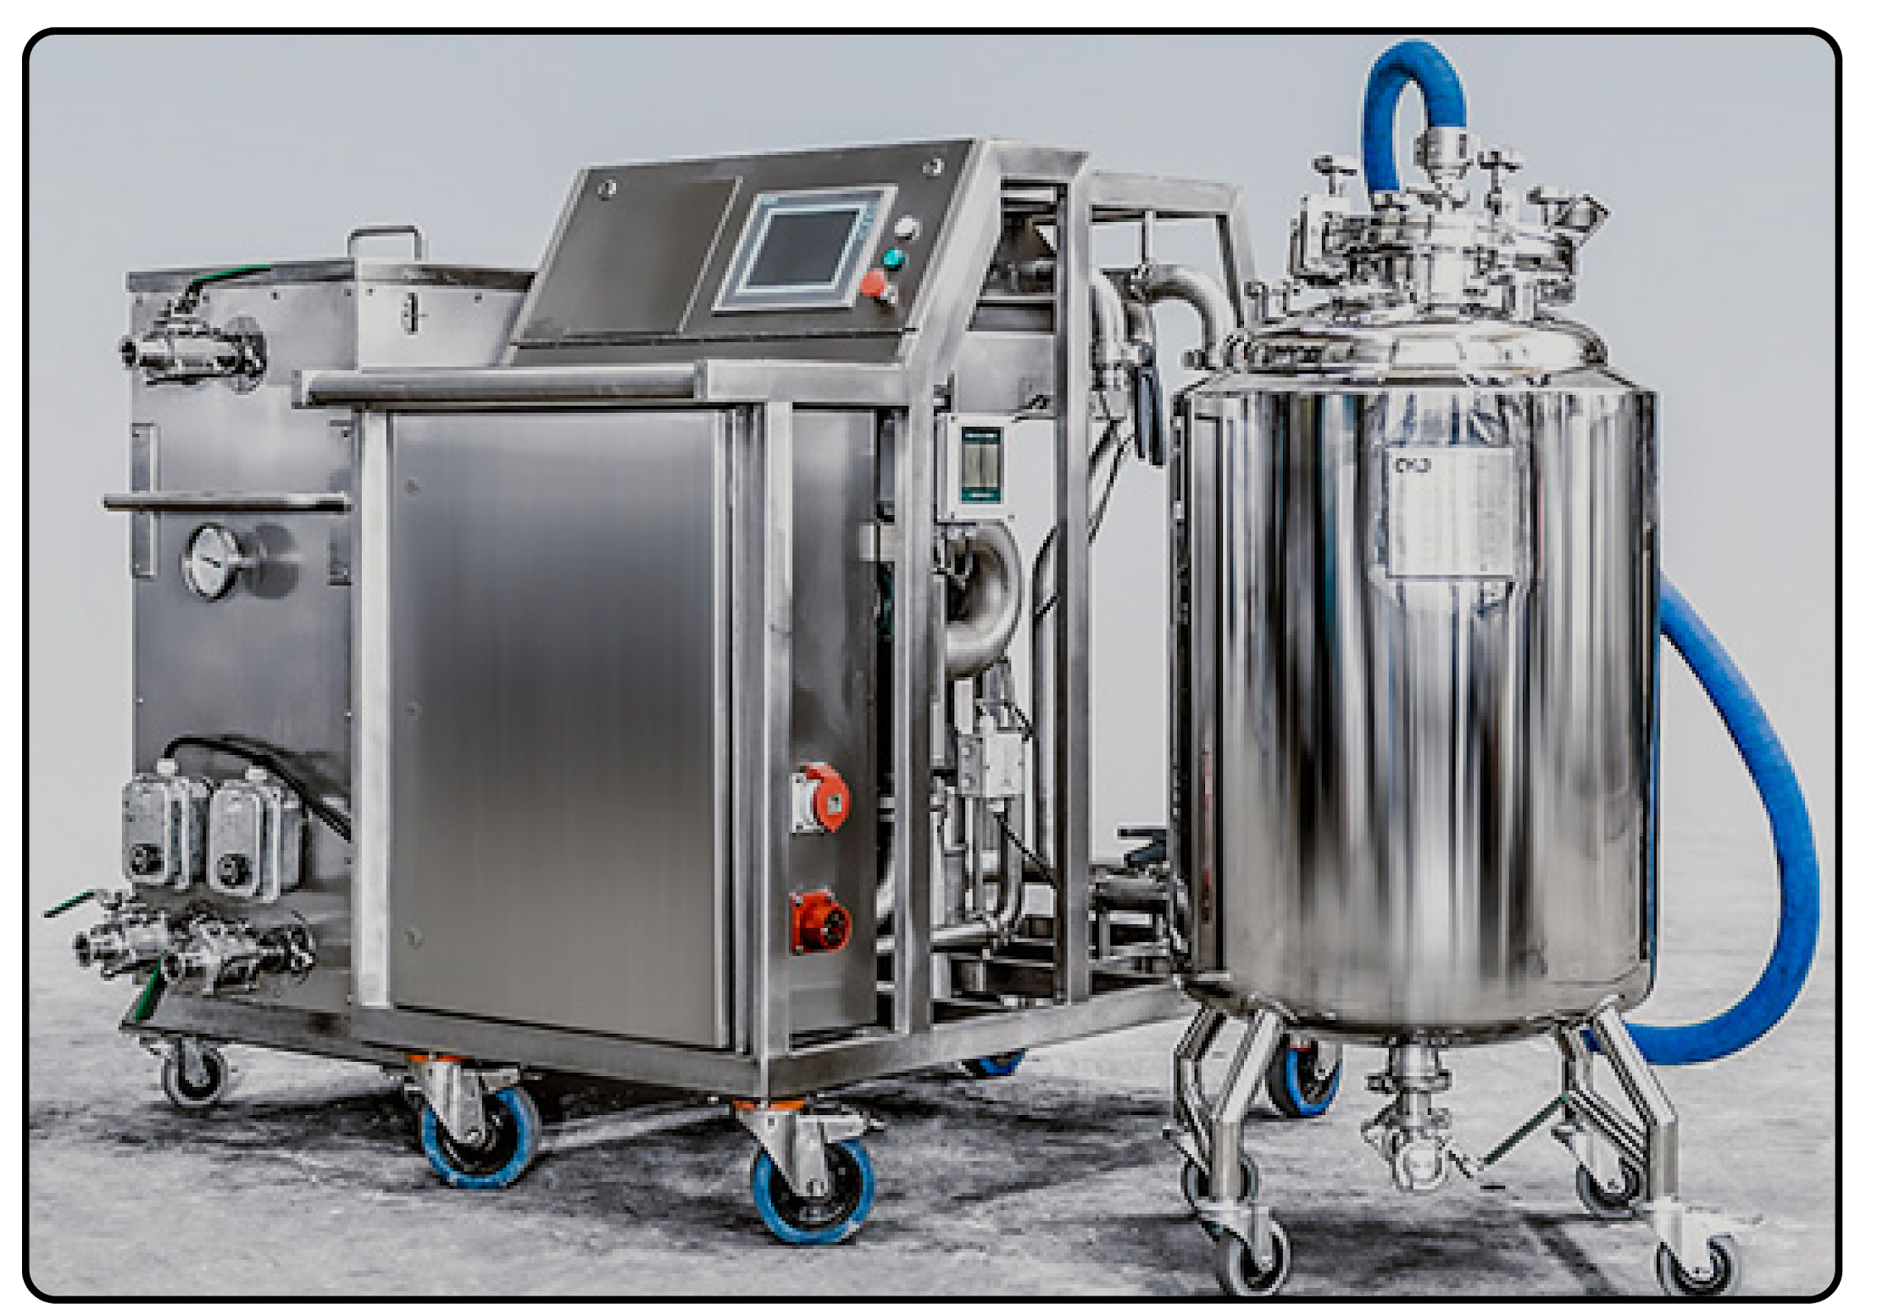
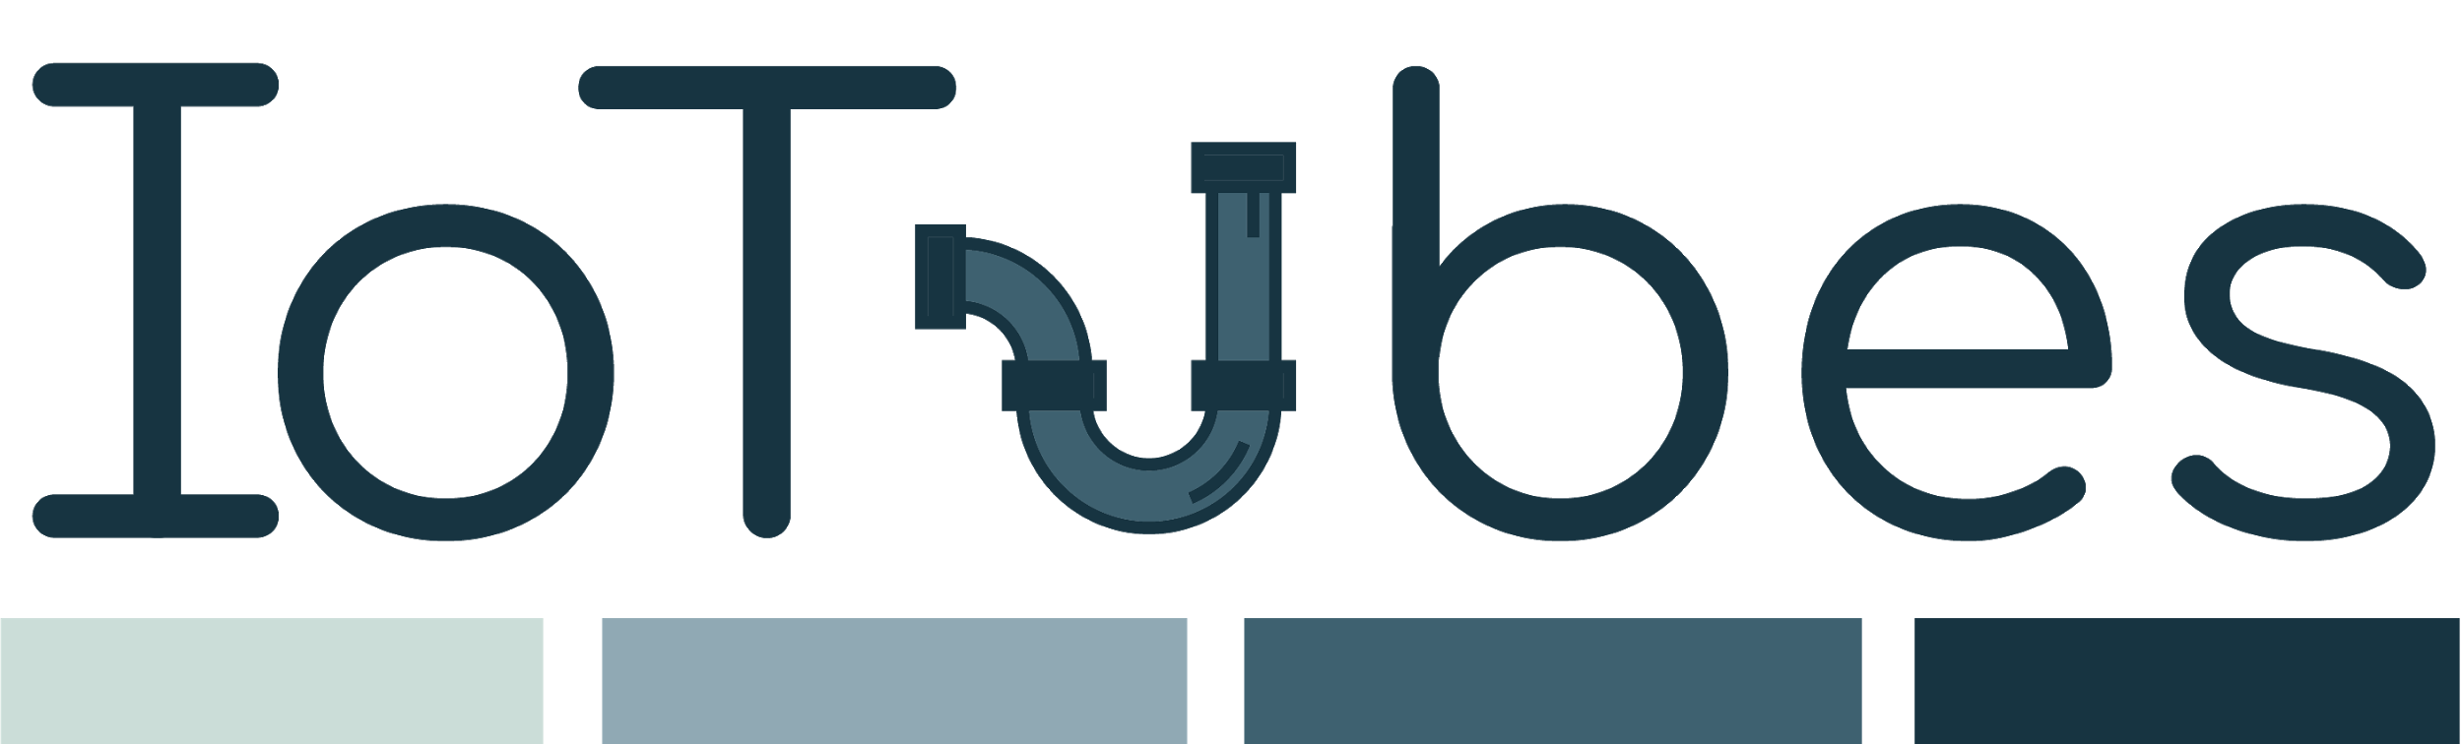
Mobile device for passivation, decontamination and resetting of industrial piping
Notes:
Hello Everyone, thank you for coming here today,
We are team 32 and we would like to present you our start-up, IoTubes, developed in collaboration with the company CKJ Steel.
IoTubes brings more Digitalization in areas of the Pharmaceutical Sector, following the dream of the Industry 4.0 concept.
We provide machines with sensors and intelligence, and we provide our customers with an IoT ecosystem which implements various services that we will talk about later.
Lets focus on the specific situation that we have at hand:
No need to present the team members, there is a slide for that later if we have time

Slide 2

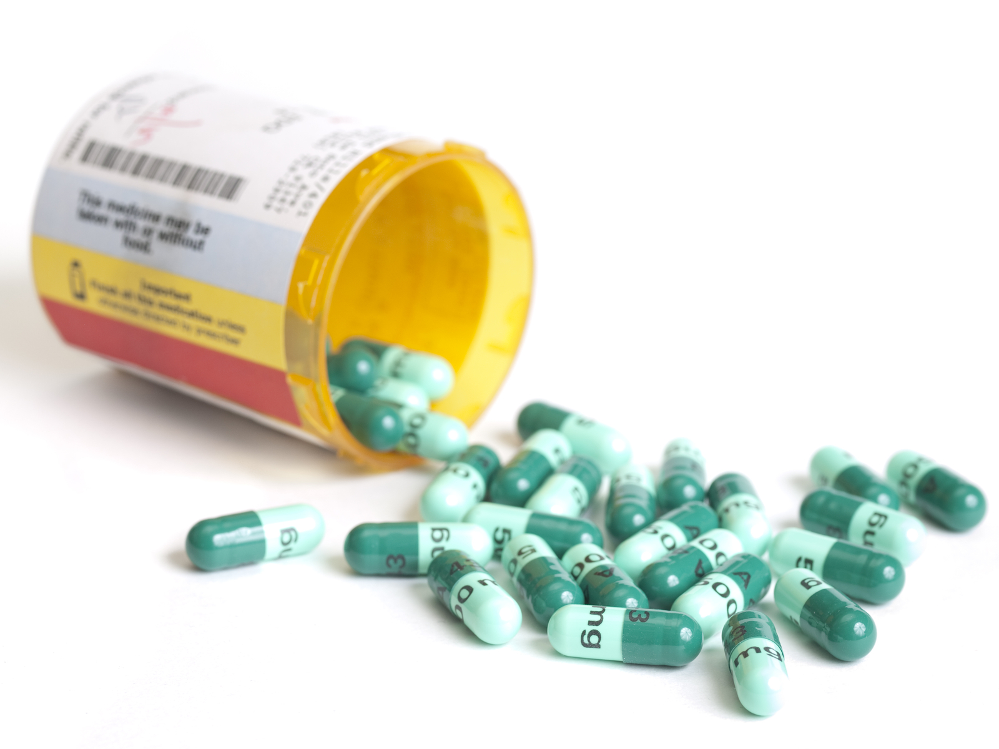
Antibiotic

Slide 3
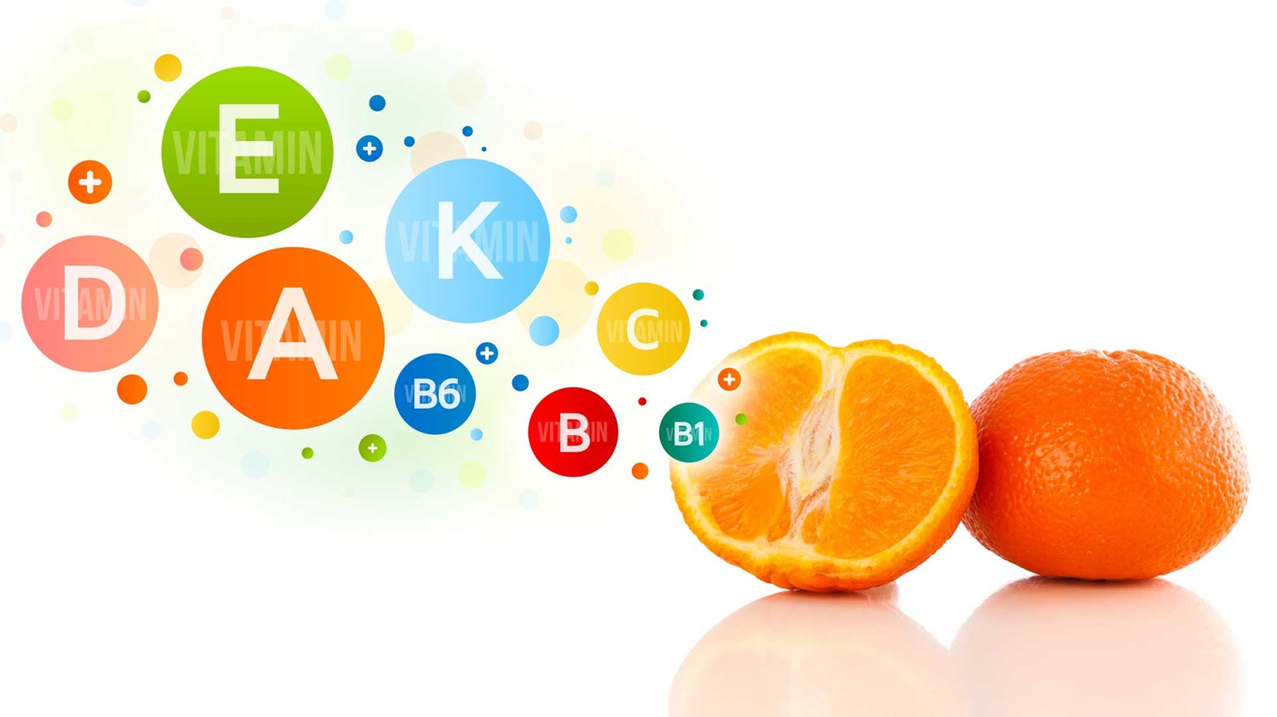
Vitamins

Slide 4
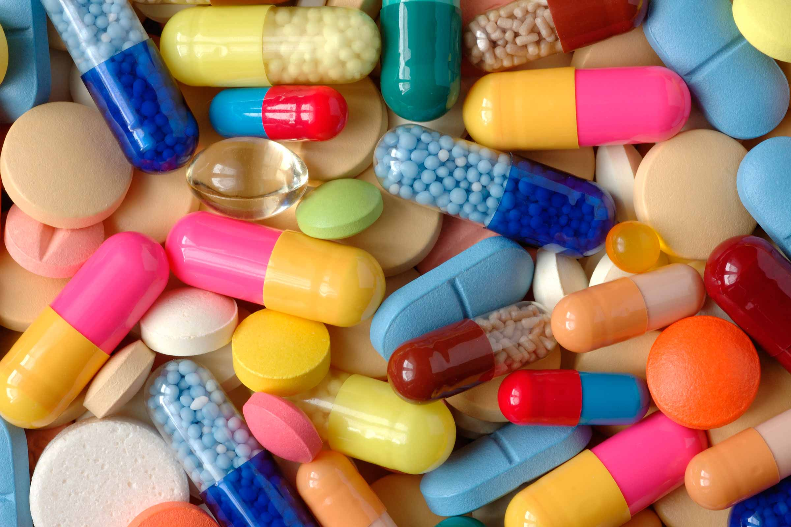
Medicine

Slide 5
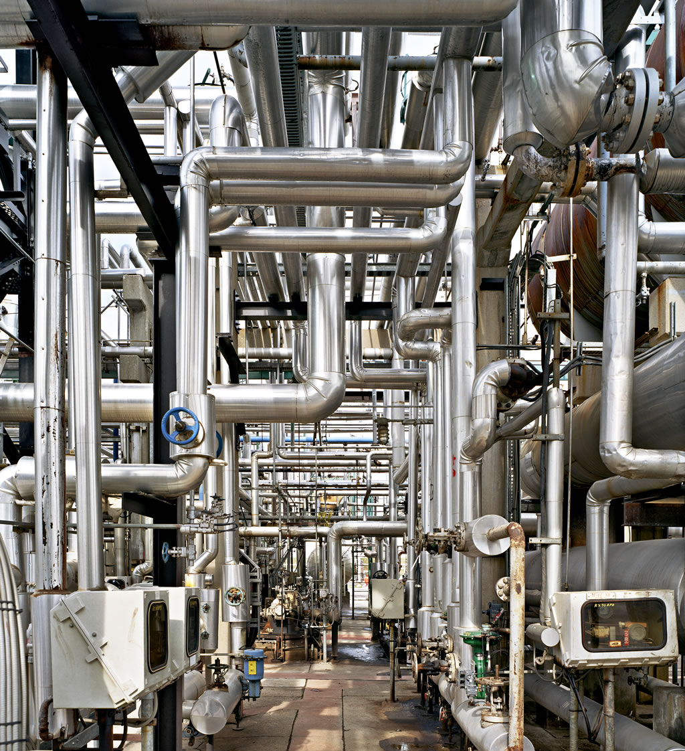
Pipelines
Production pipelines need cleaning
The duration and reliability of the cleaning process is crucial for plant operation
Notes:
Pharmaceutical companies (and others) have manufacturing pipelines where they elaborate their products, such as drugs.
Those need to be cleaned periodically, usually twice a week, while still being assembled.
How they are cleaned ? You have an external machine that pumps in an acid, a base, and water for some period of time, at a certain pressure and temperature. All of this being compliant with FDA standards.
The duration of the cleaning process being 4-6 hours.
The duration and reliability of the cleaning process is crucial for plant operation
Many pipeline systems are designed with an already existing stationary cleaning unit, called CIP.
But these are very costly, they serve only pipeline system, many of them don’t provide feedback from the system.
Industry would like a more flexible, and monitored cleaning system.

Slide 6
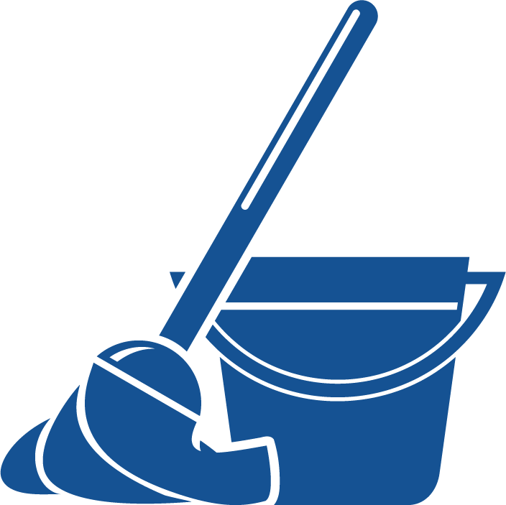
Cleaning
Circulation of proper fluid under proper conditions
Hardcoded process - no feedback information
4-6 hours, twice a week
Notes:
Pharmaceutical companies (and others) have manufacturing pipelines where they elaborate their products, such as drugs.
Those need to be cleaned periodically, usually twice a week, while still being assembled.
How they are cleaned ? You have an external machine that pumps in an acid, a base, and water for some period of time, at a certain pressure and temperature. All of this being compliant with FDA standards.
The duration of the cleaning process being 4-6 hours.
The duration and reliability of the cleaning process is crucial for plant operation
Many pipeline systems are designed with an already existing stationary cleaning unit, called CIP.
But these are very costly, they serve only pipeline system, many of them don’t provide feedback from the system.
Industry would like a more flexible, and monitored cleaning system.

Slide 7

Current solution
Stationary units, permanently placed, with no feedback info
Industry would like a more flexible, and monitored cleaning system
Notes:
Pharmaceutical companies (and others) have manufacturing pipelines where they elaborate their products, such as drugs.
Those need to be cleaned periodically, usually twice a week, while still being assembled.
How they are cleaned ? You have an external machine that pumps in an acid, a base, and water for some period of time, at a certain pressure and temperature. All of this being compliant with FDA standards.
The duration of the cleaning process being 4-6 hours.
The duration and reliability of the cleaning process is crucial for plant operation
Many pipeline systems are designed with an already existing stationary cleaning unit, called CIP.
But these are very costly, they serve only pipeline system, many of them don’t provide feedback from the system.
Industry would like a more flexible, and monitored cleaning system.

Slide 8




Cleaning-in-place mobile machine
Added Value
Report generation
Increased safety
Live monitoring & adjustments
Safety
Digitalization
Cloud Services
Mobility
Notes:
Our solution is straightforward: Our product is a cleaning in place mobile machine
Compliant with FDA standards, so it can do all the high quality cleaning procedures
It is mobile, it can fit through doors so you can use in all the pipeline systems
And it comes with this sensors and intelligence that create this added value, provinding:
Automatic Report Generation
Increased Safety and Live Monitoring
The key features of our product can be seen here (Next slide)

Slide 9
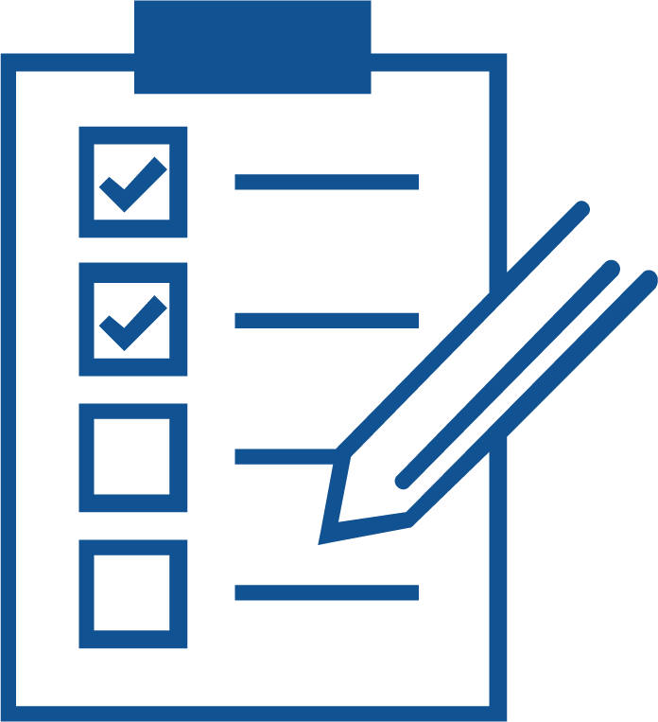
Cool story bro.
Providing the service of cleaning existing pipelines
Automation and data gathering on top of existing solutions
Flexible approach, to fit big and small needs
Notes:
Of course within the time boundaries, budget and human resources that we had in this Course we could not develop everything we would like to.
Among the things we would like to we have:
Using a spectrometer sensor within the machine to better analyze the degree of cleaning. This would allow the machine to be used in other more high tech sectors.
Create a Webapp for using the Cloud Services of the machine. Why ? Because it is 2018.
Actually trying the improved machine and getting customer experience data.

Slide 10

What if...
We could shorten the cleaning procedures?

Slide 11
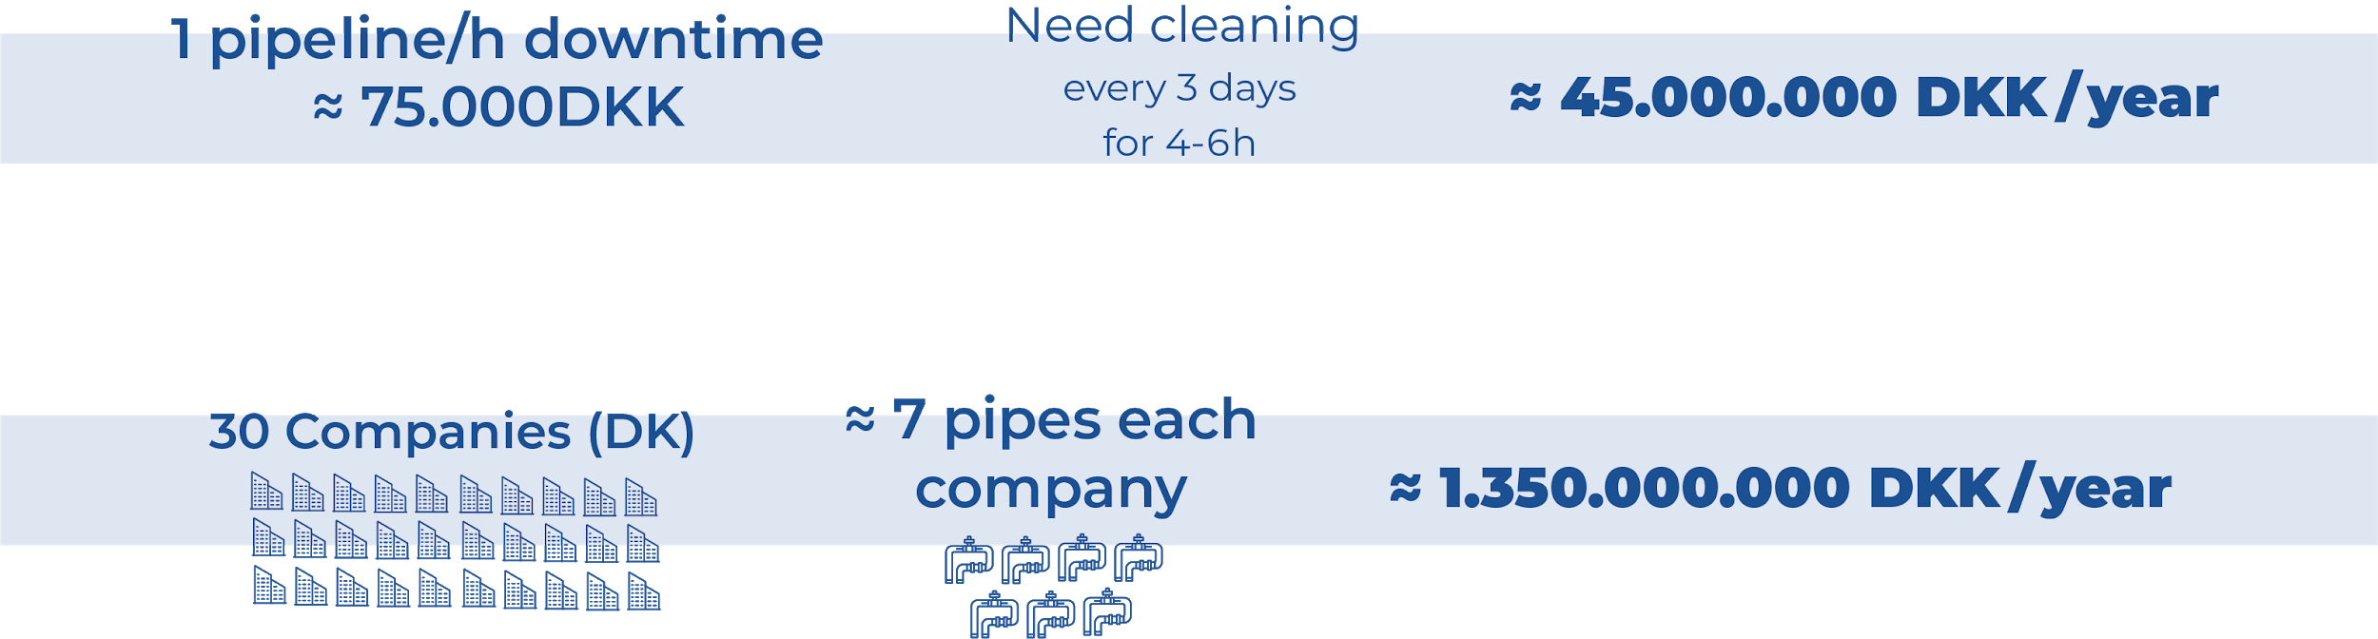
Market
Just in Pharmaceutical sector.
Food and beverages, chemicals productions etc are possible additions
Notes:
The pharmaceutical industry is quite closed up, it is very hard to get information about the costs.
From the several meetings that we had, we estimated the cost of an hour of downtime around 75.000 kr.
These need cleaning every 3 days, for around 4-6 hours, which yields around 45 million korner per year.
We also estimated that in Denmark there are around 30 companies with producition lines, with around 7 pipes per company.
Yielding over a billion KR of losses due to downtime.
This shows the importance that they give to the duration and reliability of the cleaning process.
From receipts of competitors we have seen that they are willing to pay 1/10th of this price in the cleaning procedure,
Giving a market of 100 Million Kr.

Slide 12
Unfortunately, we can’t.
Notes:
Of course within the time boundaries, budget and human resources that we had in this Course we could not develop everything we would like to.
Among the things we would like to we have:
Using a spectrometer sensor within the machine to better analyze the degree of cleaning. This would allow the machine to be used in other more high tech sectors.
Create a Webapp for using the Cloud Services of the machine. Why ? Because it is 2018.
Actually trying the improved machine and getting customer experience data.

Slide 13

Yet...
Unfortunately, we can’t.
Notes:
Of course within the time boundaries, budget and human resources that we had in this Course we could not develop everything we would like to.
Among the things we would like to we have:
Using a spectrometer sensor within the machine to better analyze the degree of cleaning. This would allow the machine to be used in other more high tech sectors.
Create a Webapp for using the Cloud Services of the machine. Why ? Because it is 2018.
Actually trying the improved machine and getting customer experience data.

Slide 14

Spectroscopy
Direct measurement of ppm of contamination
Input and output measurement allows steady state detection
Steady state detection allows routine verification and improving
Notes:
Of course within the time boundaries, budget and human resources that we had in this Course we could not develop everything we would like to.
Among the things we would like to we have:
Using a spectrometer sensor within the machine to better analyze the degree of cleaning. This would allow the machine to be used in other more high tech sectors.
Create a Webapp for using the Cloud Services of the machine. Why ? Because it is 2018.
Actually trying the improved machine and getting customer experience data.

Slide 15

Cool story bro 2.
One startup company dealing with very similar solution
Was bought by industrial gigant pretty fast.
They have successful projects, claim to shorten up to 40%
Notes:
Of course within the time boundaries, budget and human resources that we had in this Course we could not develop everything we would like to.
Among the things we would like to we have:
Using a spectrometer sensor within the machine to better analyze the degree of cleaning. This would allow the machine to be used in other more high tech sectors.
Create a Webapp for using the Cloud Services of the machine. Why ? Because it is 2018.
Actually trying the improved machine and getting customer experience data.

Slide 16
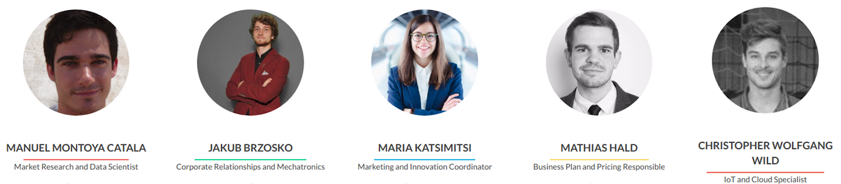
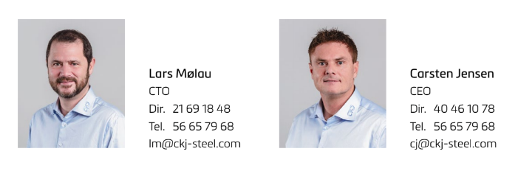
Team and Partners
Notes:
The IoTubes team is composed by 5 students, 4 of which are engineers from DTU and a Bussiness man from CBS.
Together we gather all the necessary technical and professional, hard and soft skill required for building a start up such as IoTubes.
Of Course we could not have made it without or partners from CKJ Carsten and Lars who supported us and gave us a great starting point for the project.

Slide 17

Questions
Notes:
Of course within the time boundaries, budget and human resources that we had in this Course we could not develop everything we would like to.
Among the things we would like to we have:
Using a spectrometer sensor within the machine to better analyze the degree of cleaning. This would allow the machine to be used in other more high tech sectors.
Create a Webapp for using the Cloud Services of the machine. Why ? Because it is 2018.
Actually trying the improved machine and getting customer experience data.

Slide 18
Appendix

Slide 19
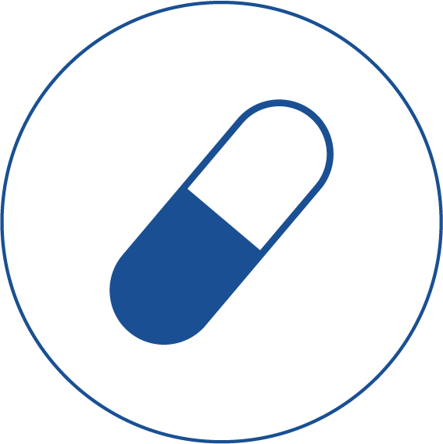
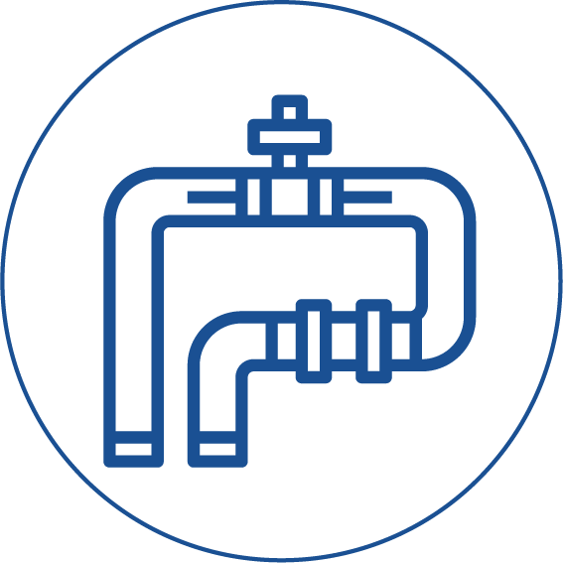
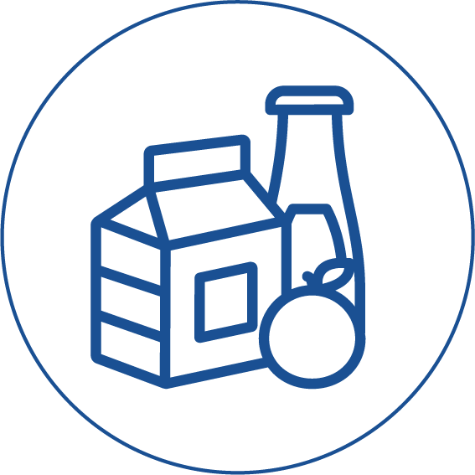
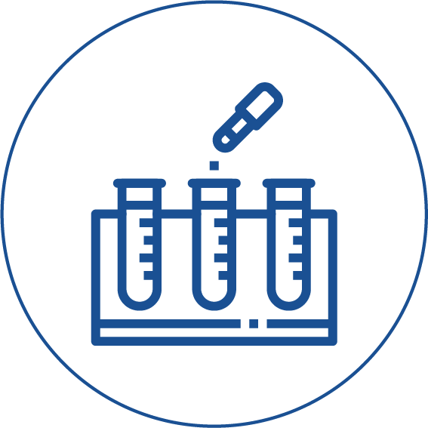
Customers
Pharmaceuticals manufacturers
Piping/ factory manufacturers
Food and drinks manufacturers
Test and research facilities
Notes:
The main customer sector are Pharmaceutical Manufacturers which require cleaning procedures compliant with FDA standards.
We can extend to other areas where it is not cost effective to have an in-place CIP or the monitoring degree of the cleaning process is not very high such as:
Piping/factory manufacturers (one time cleaning)
Test and Research facilities.
We can also supply other industries even though they do not require as high cleaning procedure as we offer.

Slide 20



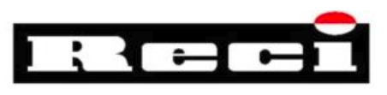

Competition
Mobile CIP for food industry:
Not applicable to Pharma industry
Passivation Underdeveloped
By-hand operations
Less reliable
No digitalization
Notes:
A mobile Cleaning unit is not a new concept so there are a few companies building these devices.
It is hard for other new players to enter the market since trust and reputation are keywords in this industry.
So how do we differentiate with them ?
The ones for Food industry such as AxFlow or Packo cannot handle the high pressure and acidic regulation of FDA.
Other companies such as Reci and Kruger do but they lack this amount of digitalization, they do their reports by hand.

